Slide 1
Angular Routing
Secondary Routes
Lecture 8
By James(Jin) Wang
12/26/2021

Slide 2
Outline
Using Secondary Routes
Defining a Named RouterOutlet
Configuring Secondary Routes
Activating Secondary Routes
Clearing Secondary Outlets

Slide 3
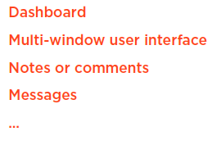
Using Secondary Route
  Secondary Routes

Slide 4
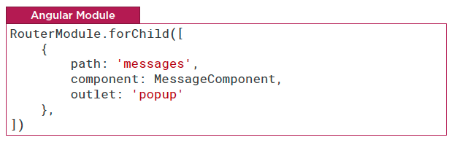
Using Secondary Route
  Configuring Secondary Routes
  Demo: configure secondary routes

Slide 5
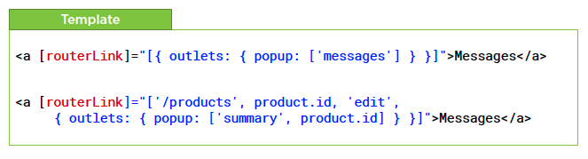
Using Secondary Route
  Activating Secondary Routes: Router Link
  Demo: activate secondary route

Slide 6
Summary

Slide 7
Assignment

Slide 8
Self Study
  Angular Routing
  https://app.pluralsight.com/library/courses/angular-routing

